Slide 1
Intro to Software Testing
Lesson 9

Slide 2

Glitch of the Day

Slide 3
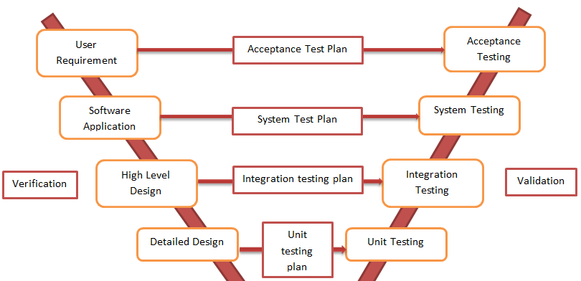



V-Model, reVisited…
What is the difference between verification & validation?

Slide 4
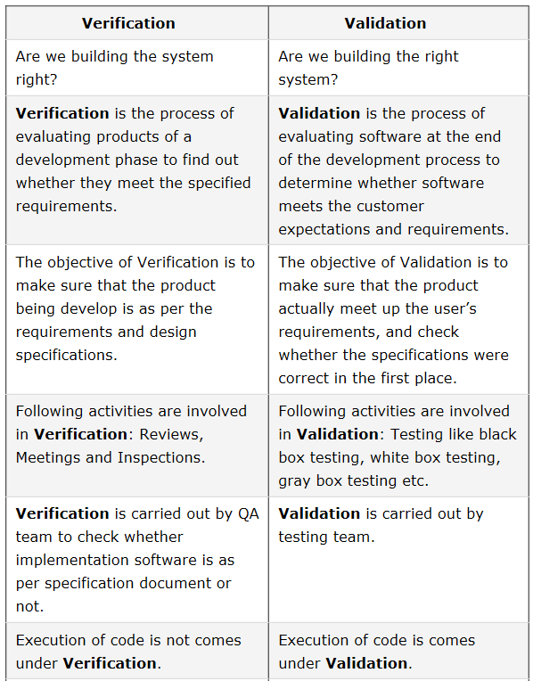
V-Model, reVisited…
Execution of the code comes under…?
What is the difference between verification & validation?
Source: http://www.softwaretestingclass.com/difference-between-verification-and-validation/

Slide 5
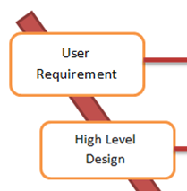

V-Model, reVisited…
What is the difference between verification & validation?
When does requirements analysis end, and design begin?

Slide 6
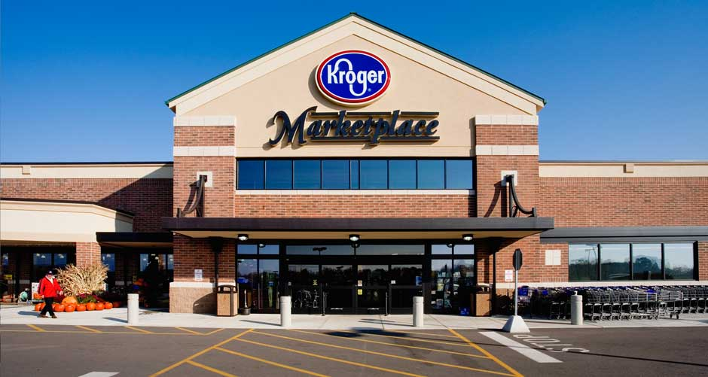
Let’s go
ing
When an item is scanned at the register during checkout,
the system shall retrieve the price of the item
from the store database, and
add that price to the customer’s subtotal.
Question: What are the requirements?

Slide 7
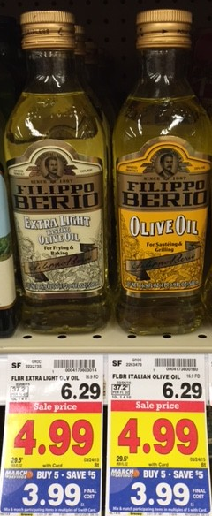
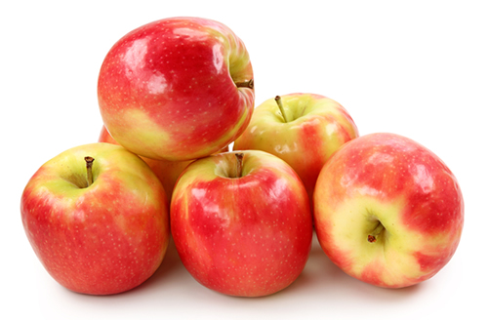
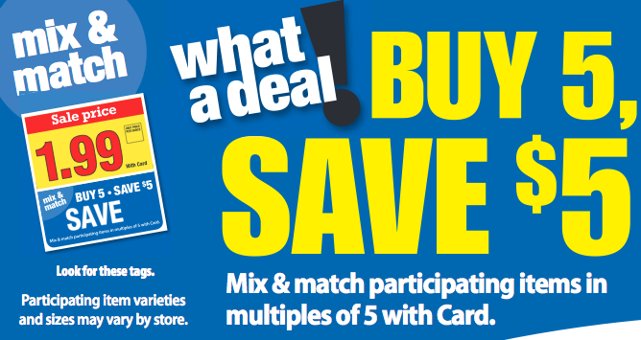
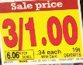

What if I buy 3?
What if I buy 1?
What if I buy 2?
What if I scan 1 of
them three times?
Olive oil?
How much
is this?
Me likes a little oil to put on
some spinach
The system shall retrieve the price of the item
from the store database, and add that
price to the customer’s subtotal.

Slide 8

V-Model, reVisited…
What is the difference between verification & validation?
When does requirements analysis end, and design begin?
What impact might this model have on scheduling?
When you test your software, do you expect to find bugs?

Slide 9

Hitch of the day
2nd Lieutenant, consulting question
3 R’s:
Writing, Running, and Repairing

Slide 10
This slide intentionally left blank

